Slide 1

ZAALIMA DEVELOPMENT
ZAALIMA
PYTHON DEVELOPMENT INTERNSHIP
A PROJECT PPT Presentation ON
“Photon: Real-time WebSocket Stock Ticker”
Presented by
Ayisha Arbin MJ
Under the guidance of
Zaalima Development Team

Slide 2
Introduction
Photon is a real-time stock dashboard
Displays live stock price updates
Uses WebSocket technology
No page refresh required
Built using Python and web technologies
Problem Statement
Traditional stock websites refresh slowly
Manual refresh causes delay
Users miss rapid price changes
Not suitable for real-time tracking

Slide 3
Project Objectives
Build a real-time stock monitoring system
Eliminate manual page refresh
Show live stock prices instantly
Visualize data using charts
Create a clean and stable dashboard
Tools & Technologies
Backend
Python
FastAPI
WebSocket
Frontend
HTML
CSS
JavaScript
Chart.js

Slide 4
System Architecture
Client connects to WebSocket server
Server generates live stock data
Data is pushed to frontend
Frontend updates UI in real-time
Architecture Components
WebSocket Server (FastAPI)
Data Generator (Mock stock data)
Frontend Dashboard
Charts & Stats Panel

Slide 5
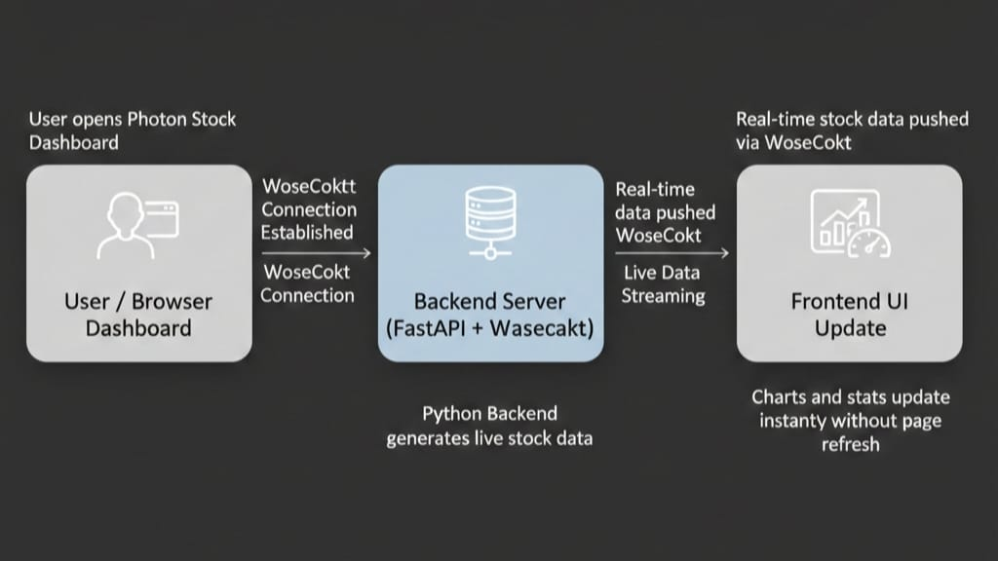
Workflow Diagram

Slide 6
Key Features
Live stock price updates
Line chart for stock price
Bar chart for volume
Date and time display
Stats panel (price & change)
Stable and responsive UI
User Experience
No page reload
Smooth real-time updates
Clean dashboard layout

Slide 7
What Makes This Project Different
Uses WebSocket instead of REST API
Real-time push-based communication
Two charts updating simultaneously
Stats panel + charts in one screen
Beginner-friendly but industry-level concept
Compared to Normal Projects
No manual refresh
Continuous live data stream
Real-time visualization

Slide 8
Sample Output
Dashboard showing:
Current stock price
Price change indicator
Live updating charts
Date and time
Output Highlights
Price updates every 2 seconds
Charts scroll smoothly
No screen flicker or disappearance

Slide 9
Advantages
Instant data updates
Fast and responsive UI
Real-time visualization
Simple and clean design
Easy to extend with real APIs
Use Cases
Stock tracking
Learning real-time systems
WebSocket demonstration project

Slide 10
Limitations
Uses mock stock data
Single stock ticker
No user authentication
Not connected to real market APIs
Current Scope
Educational and demonstration purpose

Slide 11
Future Enhancements
Connect to real stock APIs
Add multiple stock symbols
User login and preferences
Price alerts and notifications
Mobile-friendly version
Advanced Scope
React frontend
Database integration
Cloud deployment

Slide 12
Conclusion
Photon is a real-time stock dashboard
Solves delay issues in traditional apps
Demonstrates WebSocket communication
Shows live data visualization
A complete real-time web project

